Slide 1
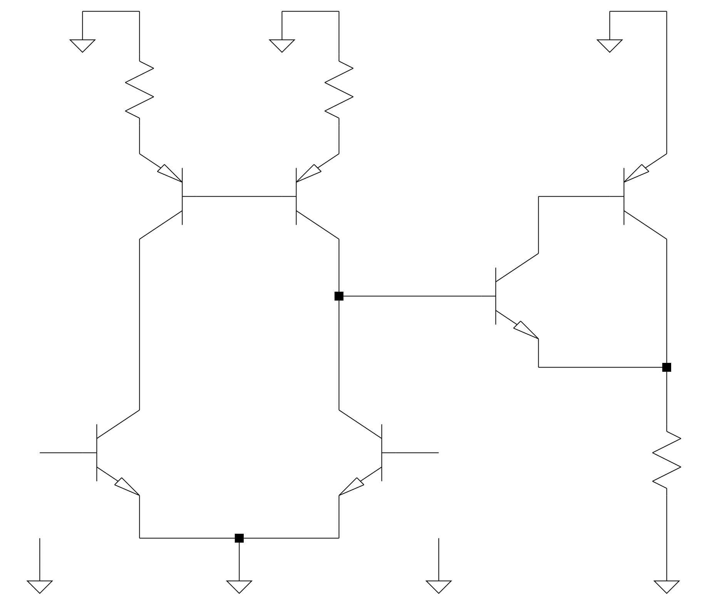

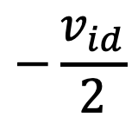




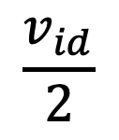














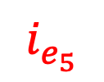
$$R_{E_{3}}$$
$$R_{E_{4}}$$
$$T_{3}$$
$$T_{4}$$
$$T_{6}$$
$$i_{c_{5}}$$
$$i_{c_{4}}$$
$$T_{5}$$
$$i_{c_{6}}$$
$$i_{b_{5}}$$
$$i_{e_{5}}$$
$$i_{c_{1}}$$
$$i_{c_{2}}$$
$$i_{o}$$
$$T_{1}$$
$$T_{2}$$
$$R_{L}$$
$$v_{o}$$
$$\frac{v_{id}}{2}$$
$$−\frac{v_{id}}{2}$$
$$v_{{be}_{1}}$$
$$v_{{be}_{2}}$$

Slide 2
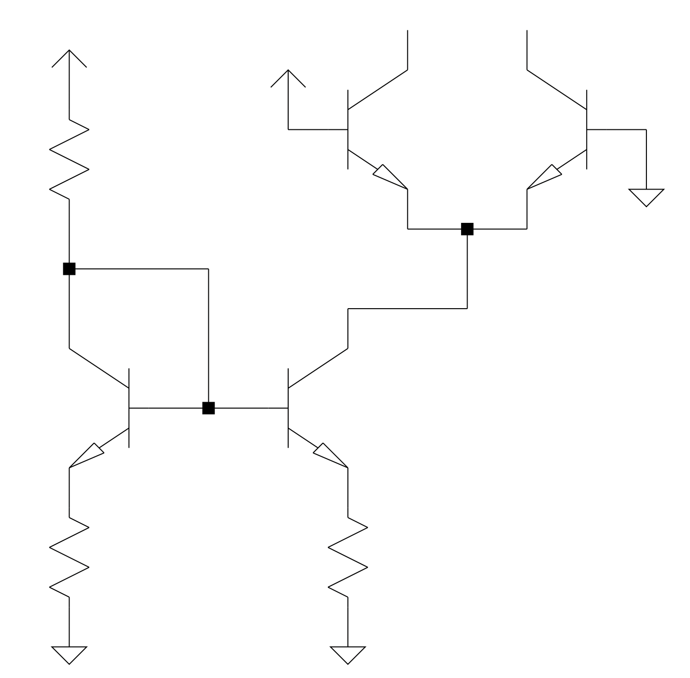
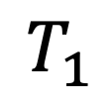
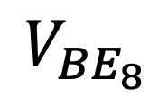


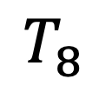
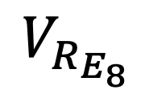

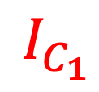
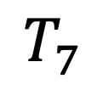
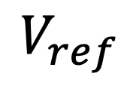


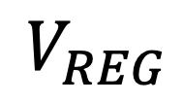
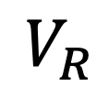

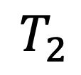
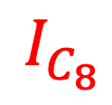
$$V_{REG}$$
$$…$$
$$…$$
$$V_{ref}$$
$$I_{C_{1}}$$
$$T_{1}$$
$$T_{2}$$
$$V_{R}$$
$$R$$
$$I_{R}$$
$$T_{7}$$
$$T_{8}$$
$$I_{C_{8}}$$
$$V_{{BE}_{8}}$$
$$R_{E_{7}}$$
$$V_{R_{E_{8}}}$$
$$R_{E_{8}}$$

Slide 3



$$R$$
$$R_{L}$$
$${−R}_{E_{8}}$$

Slide 4
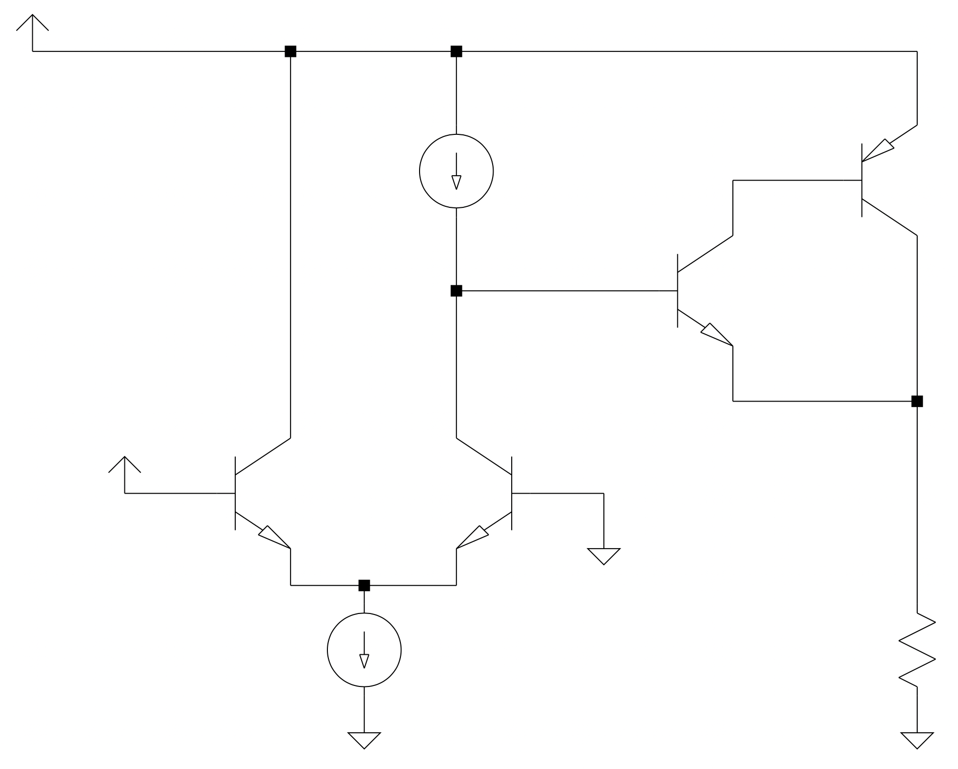
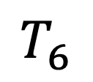
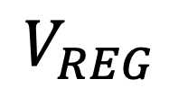
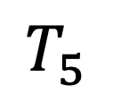
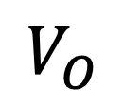
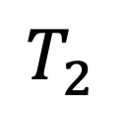
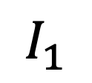
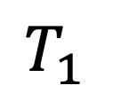
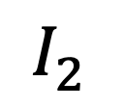
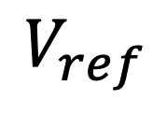
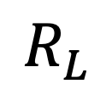
$$V_{REG}$$
$$I_{1}$$
$$T_{6}$$
$$T_{5}$$
$$V_{ref}$$
$$T_{1}$$
$$T_{2}$$
$$I_{2}$$
$$R_{L}$$
$$V_{O}$$

Slide 5
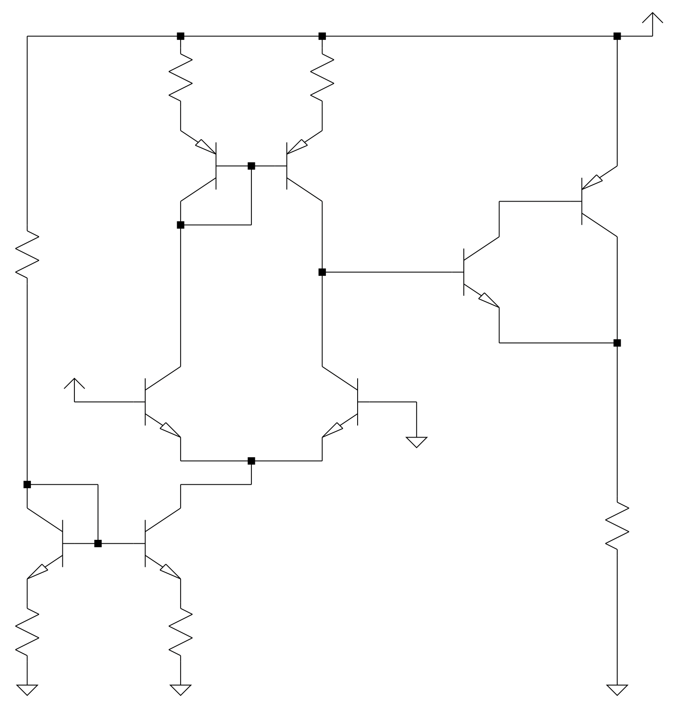
















$$V_{REG}$$
$$R_{E_{3}}$$
$$R_{E_{4}}$$
$$T_{3}$$
$$T_{4}$$
$$T_{6}$$
$$R$$
$$T_{5}$$
$$V_{ref}$$
$$T_{1}$$
$$T_{2}$$
$$R_{L}$$
$$V_{O}$$
$$T_{7}$$
$$T_{8}$$
$$R_{E_{7}}$$
$$R_{E_{8}}$$

Slide 6
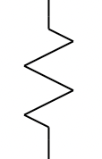

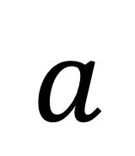



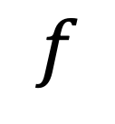
$$V_{REG}$$
$$a$$
$$V_{ref}$$
$$R_{L}$$
$$V_{O}$$
$$f$$

Slide 7
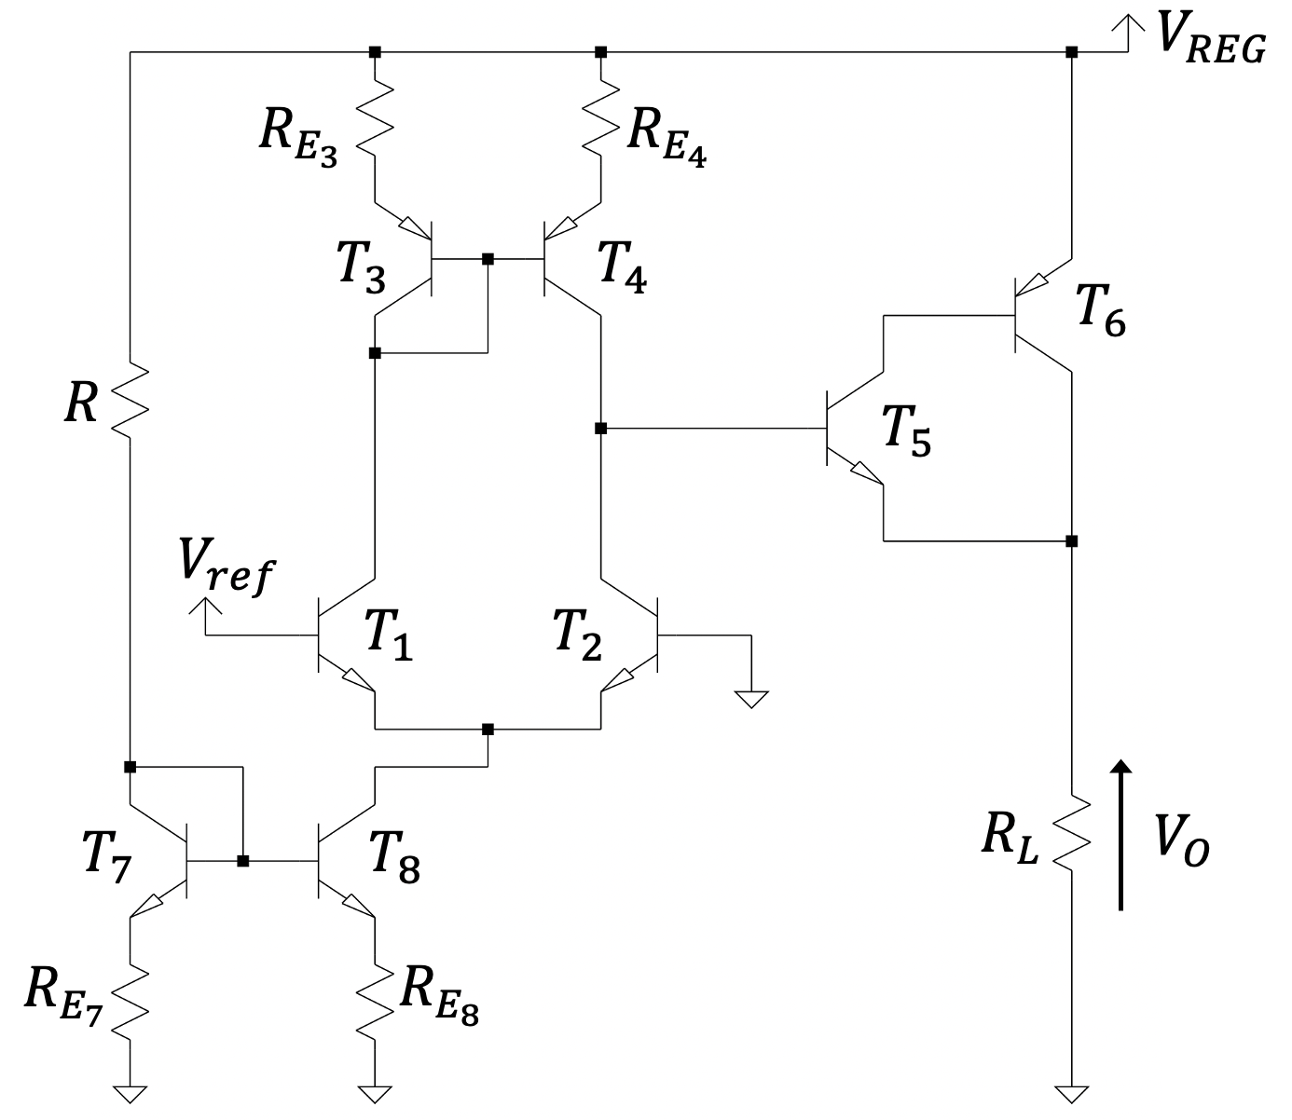
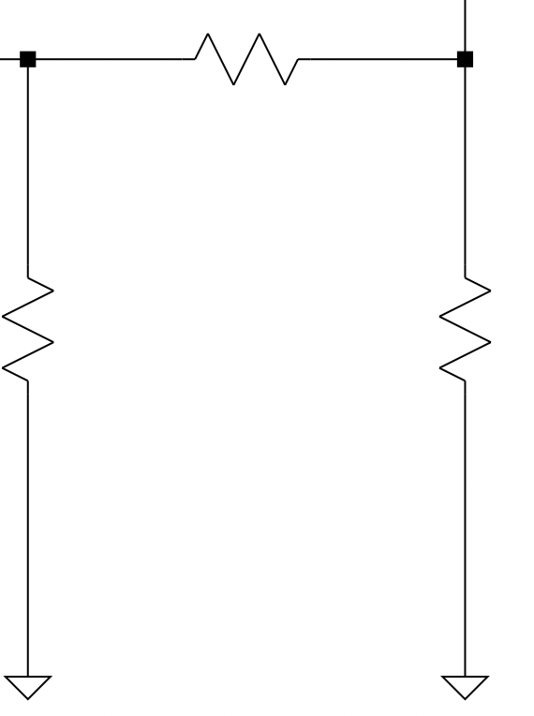


$$R_{1}$$
$$R_{2}$$
$$R_{L}$$

Slide 8
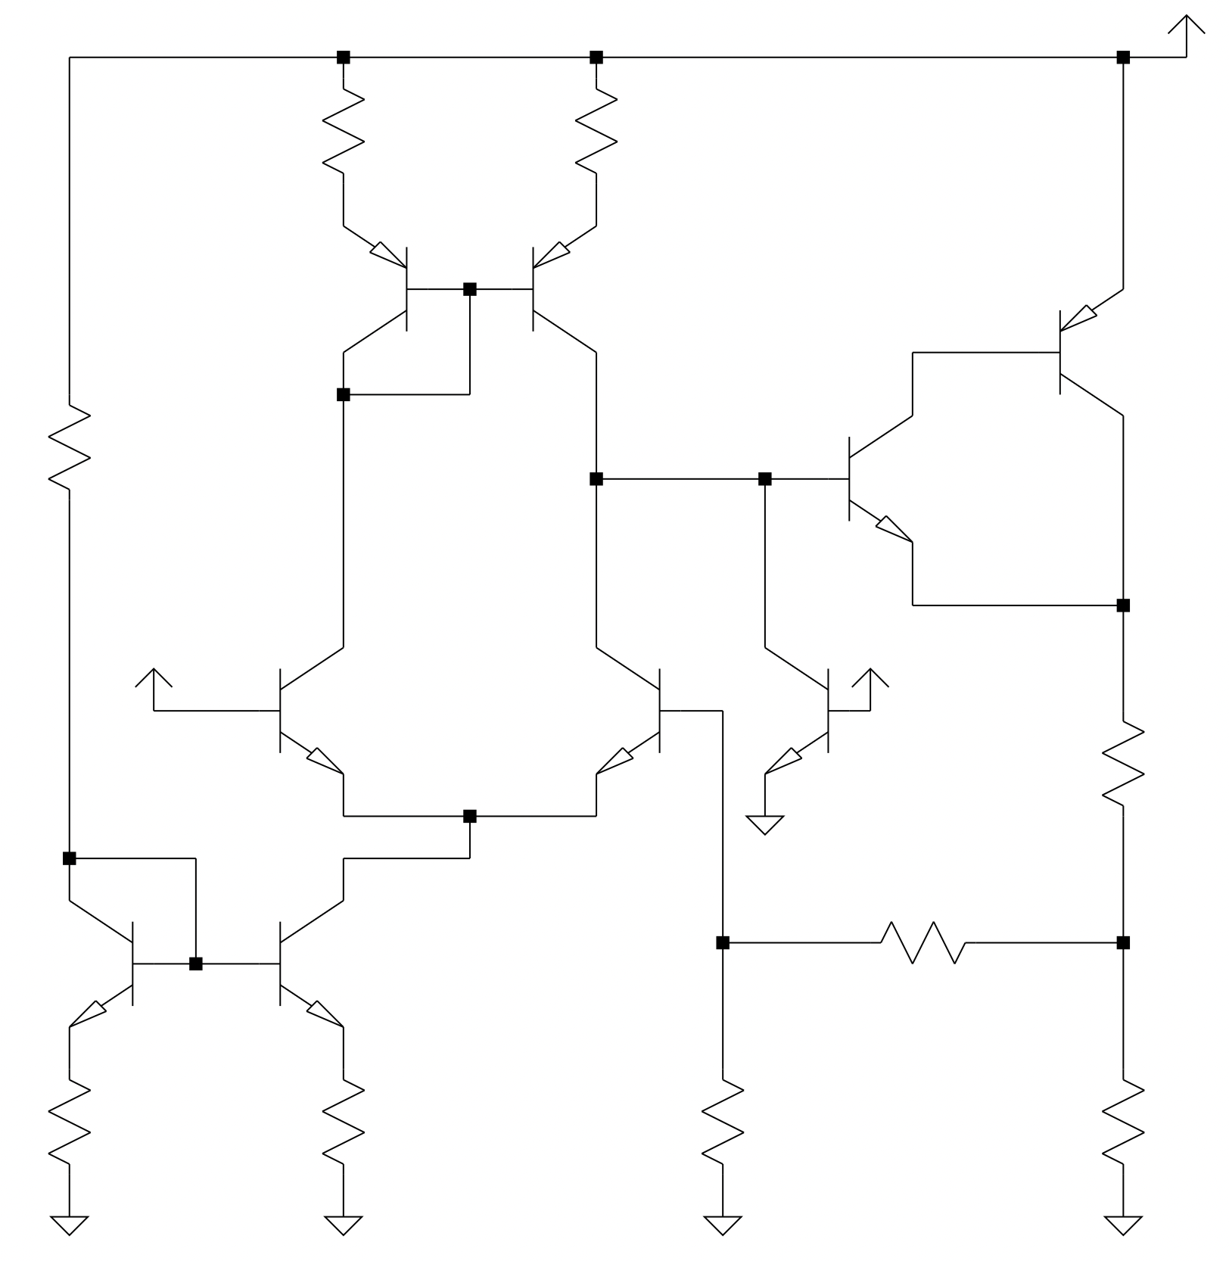










$$V_{REG}$$
$$R_{E_{3}}$$
$$R_{E_{4}}$$
$$T_{3}$$
$$T_{4}$$
$$T_{6}$$
$$R$$
$$T_{5}$$
$$V_{ref}$$
$$V_{f}$$
$$T_{1}$$
$$T_{2}$$
$$T_{LC}$$
$$R_{S}$$
$$V_{x}$$
$$T_{7}$$
$$T_{8}$$
$$R_{1}$$
$$R_{E_{7}}$$
$$R_{E_{8}}$$
$$R_{2}$$
$$R_{L}$$
$$V_{O}$$

Slide 9
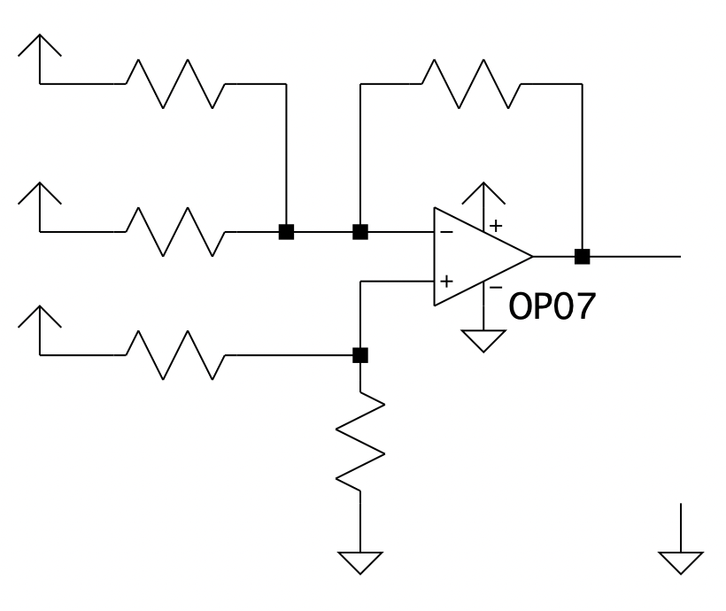
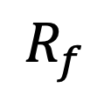
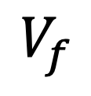
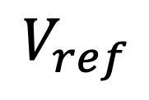
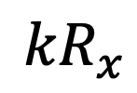





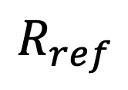
$$V_{ref}$$
$$R_{ref}$$
$$R_{f}$$
$$V_{O}$$
$$V_{REG}$$
$$R_{O}$$
$$V_{x}$$
$$V_{f}$$
$${kR}_{x}$$
$$R_{x}$$

